Slide 1
IN THE NAME OF GOD

Slide 2
Human rights and Medical ethics
Seyed Ali Malek-Hosseini, MD
Professor of Hepatopancreatobiliary and Transplant Surgery, Organ Transplant Unit, Department of Surgery, Shiraz University of Medical Sciences Shiraz, Iran
President, Iranian Society for Organ Transplantation
CEO and Founder, Avicenna Transplantation Institute, Shiraz, Iran

Slide 3
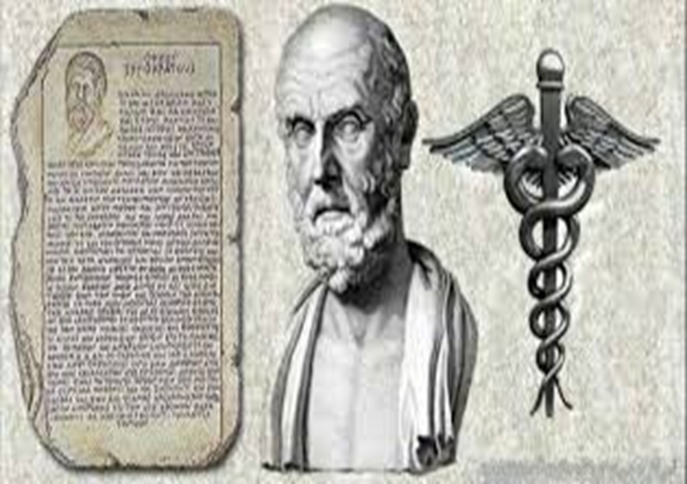
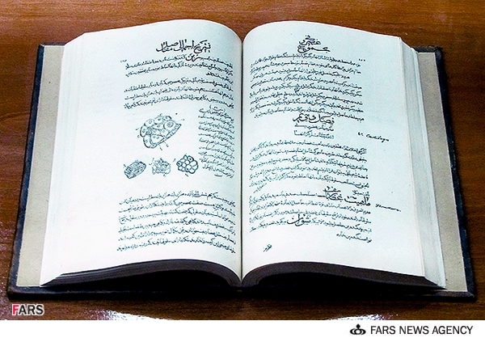
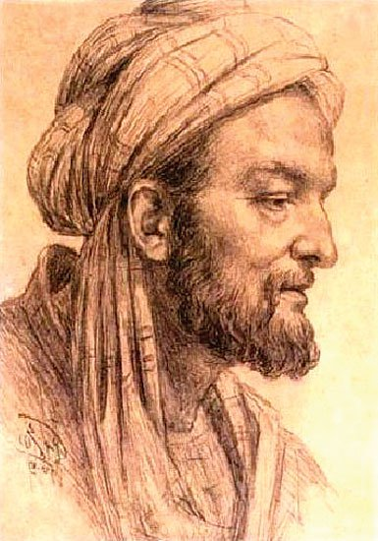
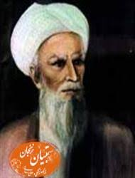
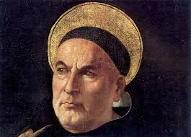
History
Avicenna 980-1037
Traced to Hippocrates Oath : 5th century BC
Islamic scholars
Avicenna's Canon of Medicine
Muhammad ibn Zakariya al-Razi
Jewish scholar: Maimonides
Catholic scholar: Thomas Aquinas
Thomas Aquinas
Spain :1135-1204
Italia: 1225-1274
موسی بن میمون

Slide 4
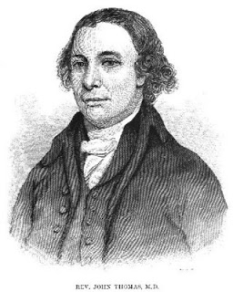
History contd.
Modern code of medical ethics : 1803
Thomas Percival published a document about :
Requirements and expectations of medical professionals within medical facilities
1st code of ethics adopted : 1847
Percival
( 1740 – 1804)

Slide 5
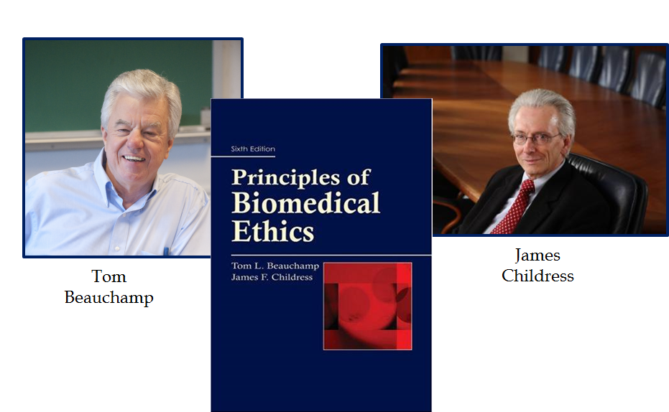
Principles of medical ethics
Textbook of Principles of biomedical ethics(1979) by :
Tom Beauchamp and James Childress
Respect for autonomy : the right of patient to refuse or choose treatment
Beneficence : practitioner should act in the best interest of the patient
Non-maleficence : to not cause harm (first, do no harm)
Justice :
distribution of scarce health resources
decision for who gets what treatment

Slide 6
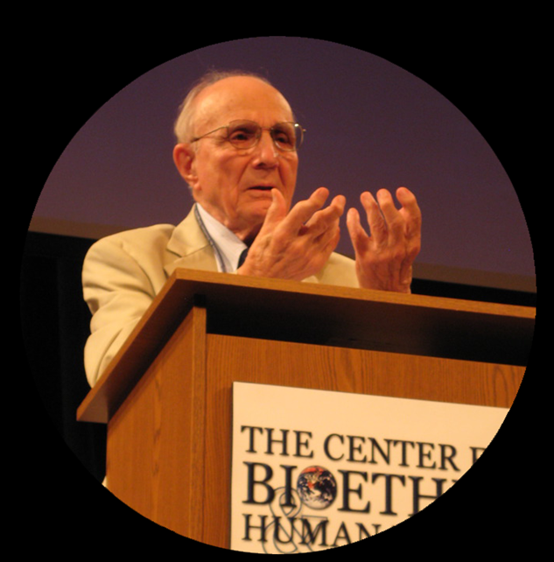
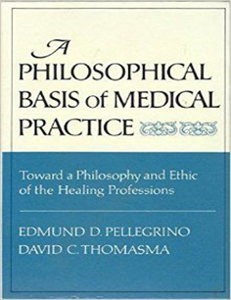
Principles of medical ethics cont’d
Edmund Daniel Pellegrino (distinguished professor of medicine and medical ethics) argue :
Only principle of medical ethics : Beneficence
The sole purpose of medicine : Healing
cosmetic surgery and euthanasia : unethical and against the Hippocratic Oath

Slide 7
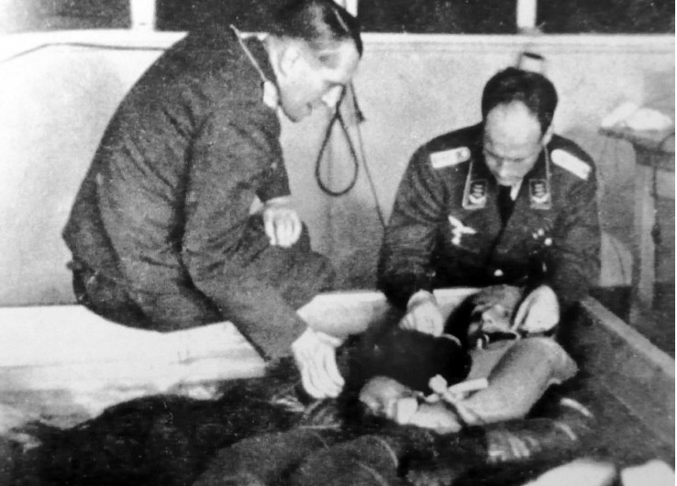
Example of dreadful experiments in the 20th century
Nazi human experiments during world war II at concentration camps on prisoners including children
Sterilization to exterminate Jewish minority to Purified Arian
Master race ( Nazism ideology)

Slide 8
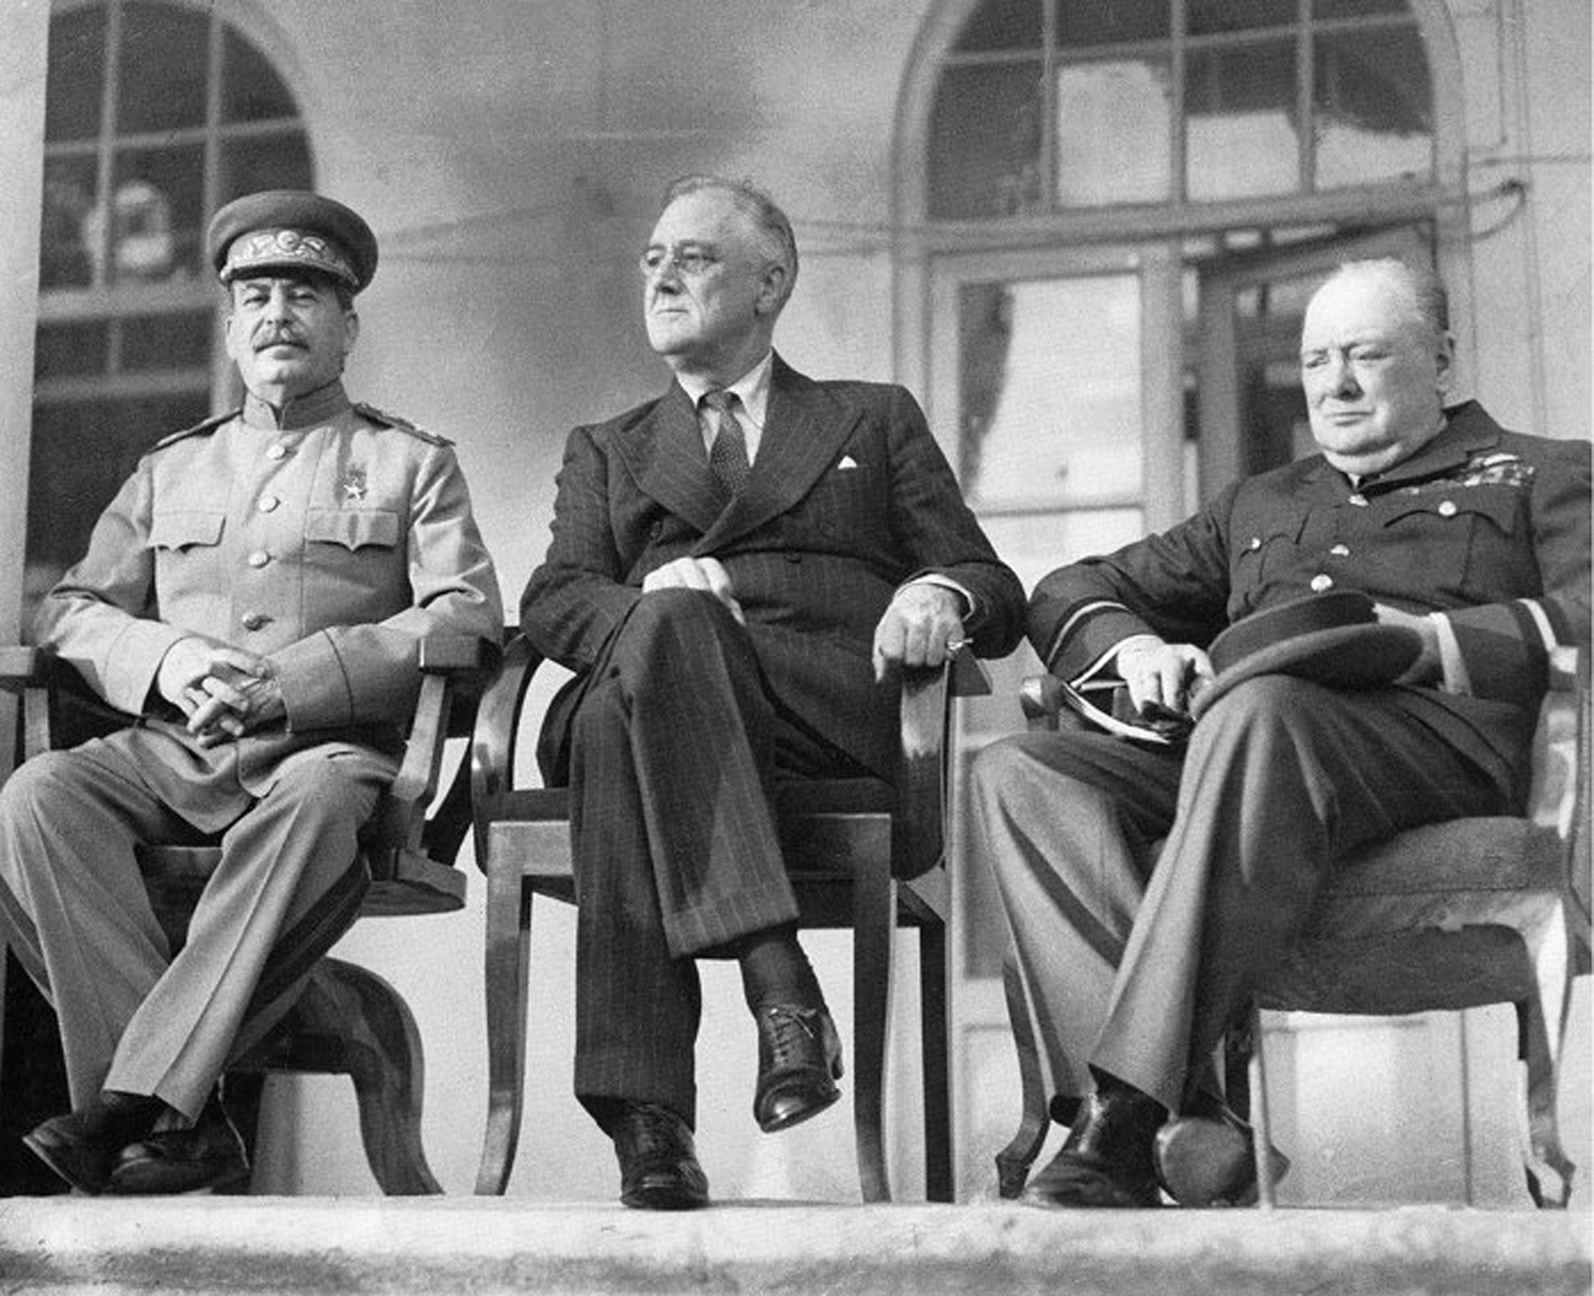
Nuremberg trials Military tribunals For prosecution of political, military, judicial and economic leadership of Nazi , participated in the Holocaust and other war crimes
Background
1940 : The Polish government-in-exile asked the British and
French governments to condemn the German invasion of their country
2. 1943 : the Soviet Union, the UK and the US published :
"Declaration on German Atrocities in Occupied Europe which states :
when the Nazis were defeated, the Allies would "pursue them to the uttermost ends of the earth in order that justice may be done
3. 1943 : Tripartite Dinner Meeting at Tehran Conference between : Josef Stalin , Franklin D Roosevelt and Sir Winston Churcill
Joseph Stalin
Franklin D. Roosevelt
Sir Winston Churchill

Slide 9
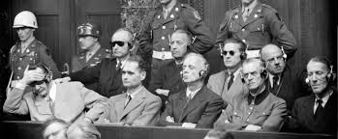
Nuremberg trials cont’d
20 November 1945 to 1 September 1946 in the Bavarian city of Nuremberg
Nuremberg was chosen for two reasons :
I. The Palace of Justice was spacious and largely undamaged during war
II. Nuremberg was considered the ceremonial birthplace of the Nazi Party
Agreement between three major wartime powers ( UK, US, and Soviet Union)
France awarded a place on the tribunal
Legal basis for the trial : London Charter (crimes against peace, war crimes, and crimes against humanity)
One judge and an alternative from each of four countries
Some 200 German war crimes defendants were tried
The 24 accused were , with respect to each charge convicted (death penalty or imprisonment) or non convicted (acquitted or no decision)

Slide 10
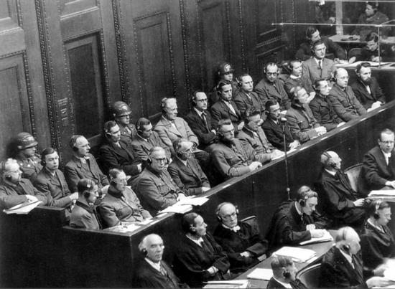
Nuremberg trials cont’d
As a result of the Nuremberg trial a set of guidelines document were created
German doctors that conducted medical experiments in concentration camps tried in the so-called “Doctors' Trial”
The Doctors' trial lasted from 9 December 1946 until 20 August 1947
Doctors' Trial led to the creation of the Nuremberg Code :
a set of research ethics principles for human experimentation

Slide 11
Nuremberg Code
The voluntary consent of the human subject is absolutely essential.
The experiment should be such as to yield fruitful results for the good of society, unprocurable by other methods or means of study, and not random and unnecessary in nature.
The experiment should be so designed and based on the results of animal experimentation and a knowledge of the natural history of the disease or other problem under study that the anticipated results will justify the performance of the experiment.
The experiment should be so conducted as to avoid all unnecessary physical and mental suffering and injury.
No experiment should be conducted where there is an a priori reason to believe that death or disabling injury will occur; except, perhaps, in those experiments where the experimental physicians also serve as subjects.
The degree of risk to be taken should never exceed that determined by the humanitarian importance of the problem to be solved by the experiment.

Slide 12
Nuremberg Code cont’d
Proper preparations should be made and adequate facilities provided to protect the experimental subject against even remote possibilities of injury, disability, or death.
The experiment should be conducted only by scientifically qualified persons. The highest degree of skill and care should be required through all stages of the experiment of those who conduct or engage in the experiment.
During the course of the experiment the human subject should be at liberty to bring the experiment to an end if he has reached the physical or mental state where continuation of the experiment seems to him to be impossible.
During the course of the experiment the scientist in charge must be prepared to terminate the experiment at any stage, if he has probable cause to believe, in the exercise of the good faith, superior skill and careful judgment required of him that a continuation of the experiment is likely to result in injury, disability, or death to the experimental subject.

Slide 13
Declaration of Geneva
After World War II , World Medical Association (WMA) accepted the responsibility for setting ethical guidelines for the world physicians
A study committee was appointed to prepare a "Charter of Medicine"
an oath or promise that every doctor would make upon receiving his/her medical
degree
Two years of intensive study of the oaths and promises by study committee resulted to a modernized wording of the ancient oath of Hippocrates
1948 : WMA's general assembly in Geneva adopted it
Amended in :
1968 (Sydney)
1983 (Venice)
1994 (Stockholm)
2017 (Chicago)

Slide 14
Declaration of Geneva cont’d modernized wording of the ancient oath of Hippocrates
AS A MEMBER OF THE MEDICAL PROFESSION:
I SOLEMNLY PLEDGE to dedicate my life to the service
THE HEALTH AND WELL-BEING OF MY PATIENT will be my first consideration
I WILL RESPECT the autonomy and dignity of my patient
I WILL MAINTAIN the utmost respect for human life
I WILL NOT PERMIT considerations of age, disease or disability, creed, ethnic origin, gender, nationality, political affiliation, race, sexual orientation, social standing or any other factor to intervene between my duty and my patient
I WILL RESPECT the secrets that are confided in me, even after the patient has died

Slide 15
Declaration of Geneva cont’d modernized wording of the ancient oath of Hippocrates
I WILL PRACTICE my profession with conscience and dignity and in accordance with good medical practice
I WILL FOSTER the honor and noble traditions of the medical profession
I WILL GIVE to my teachers, colleagues, and students the respect and gratitude that is their due
I WILL SHARE my medical knowledge for the benefit of the patient and the advancement of healthcare
I WILL ATTEND TO my own health, well-being, and abilities in order to provide care of the highest standard
I WILL NOT USE my medical knowledge to violate human rights and civil liberties, even under threat
I MAKE THESE PROMISES solemnly, freely and upon my honour

Slide 16
Declaration of Helsinki
Public opinion was shocked by the
Thalidomide scandal : 1961
Developed for the medical community by
the World Medical Association (WMA): 1964
Guidance for performing research in human
beings
Many children were born with phocomelia as a side effect of the drug thalidomide

Slide 17
Declaration of Helsinki
1964 : Helsinki (11 paragraphs)
seven revisions :
First revision: 1975
Second: 1983
Third: 1989
Fourth:1996
Fifth: 2000
Sixth: 2008
Seventh: 2013 (37paragraphs)

Slide 18
Declaration of Helsinki cont‘d Principles
Thorough knowledge of the scientific background
Careful assessment of risks and benefits
Reasonable likelihood of benefit to the population studied
Conducted by trained investigators using approved protocols
The protocol should address the ethical issues

Slide 19
Declaration of Helsinki cont‘d Principles
Discontinue in any point if :
original considerations are no longer satisfied
The study should be publicly available
Comparison of experimental investigations against the best methods
The interests of the subject, should be part of the overall ethical assessment after completion
Unproven methods should be tested if reasonable belief of possible benefit

Slide 20
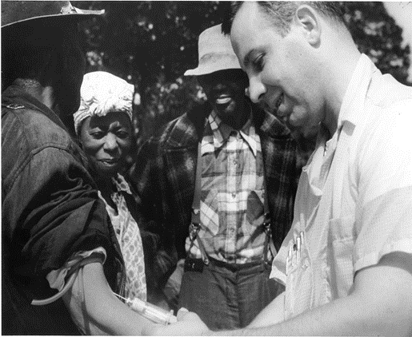
The Tuskegee study of untreated syphilis in the African American men
An infamous and most shameful study for natural history of Syphilis by U.S. Public Health Service (1932- 1972)
Started in 1932 in collaboration with Tuskegee university in Macon county , Alabama
Enrolled in the study 600 impoverished men , 399 syphilitic and 201 did not have the disease
The men were given free medical care , meals and free burial insurance
The men were told that they were being treated for ‘’bad blood’’
Researchers knowingly failed to treat patients even after validation of penicillin even prevented participants from accessing treatment
7. Told them that study was only going to last 6 months but actually lasted 40 years

Slide 21
Belmont commission Feb. 1976 Guidelines for the Protection of Human Subjects
Created by the National commission for the protection of human subjects
of biomedical and behavioral research
2. Prompted by scandal of Tuskegee Syphilis Study
3. Held in Belmont conference center part of Smithsonian Institution,
Elkridge Maryland
4. Issued on 30 September 1978 and Published on 18 April 1979

Slide 22
Brief review of the Belmont Report
7 things must be done to ensure the rights of the participant is met
Ensure the study is approved by an IRB
Get informed consent from the patient
Ensure that the patient understands the full extent of the experiment, and if not, will contact the study coordinator
Ensure the patient wasn't coerced into doing the experiment by means of threatening or bullying
Be careful of other effects of the clinical trial that were not mentioned, and report it to the proper study coordinator
Support the privacy of the patient's identity, their motivation to join or refuse the experiment.
Ensure that all patients at least get the minimal care needed for their condition

Slide 23
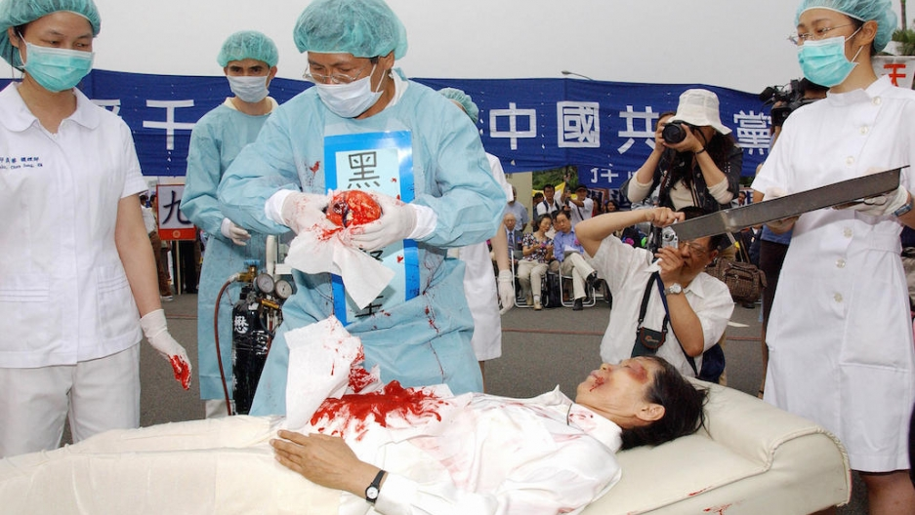
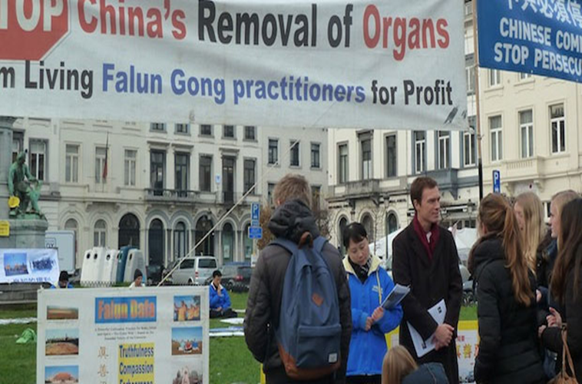
A horrible example of unethical and immoral behavior in the history of organ transplantation
Harvesting organ from Falun Gong prisoners in China
Falun Gong practitioners are follower of Buddhist tradition
Communist Party leader initiated persecution of these in 1999
Reports on systematic organ harvesting of Falun Gong prisoners emerged in 2006
Some believe this dreadful practice had started since 2000 and tens of thousands were executed

Slide 24
The Transplantation Society (TTS) and the International Society of Nephrology (ISN)

Slide 25
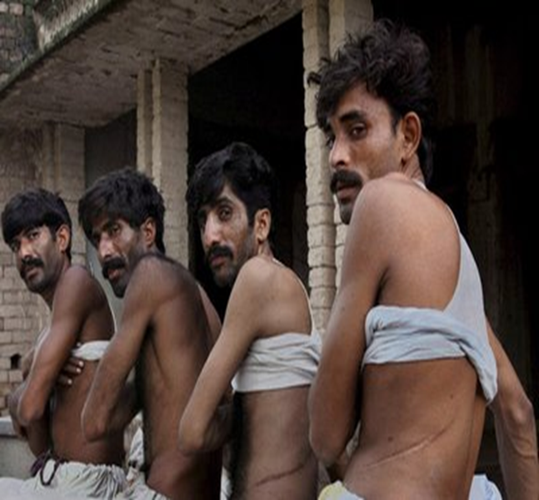
The Declaration of Istanbul (TTS , ISN ) 30 April to 1 May 2008
Global problems due to organ shortage :
organ trafficking
transplant tourism
transplant commercialism
Threaten human rights and medical ethics
because targeting of vulnerable people as:
illiterate
impoverished
undocumented immigrants
prisoners
political or economic refugees
exploited by rich patient-tourists as source of organs
estimated 10% of organ transplants that are performed annually around the world

Slide 26
The Declaration of Istanbul (TTS , ISN ) 30 April to 1 May 2008 cont’d
Clarifies the issues of transplant tourism, trafficking and commercialism and provides ethical guidelines for practice in organ donation and transplantation
Since the creation of the declaration, over 100 countries have endorsed the principles
Some nations have subsequently strengthened their laws against commercial organ trade, including China, the Philippines, and Pakistan

Slide 27
The Declaration of Istanbul (TTS , ISN ) 30 April to 1 May 2008 cont’d
Adopted in 2008
Establishment of Declaration of Istanbul Custodian Group (DICG) : 2010
Reviewing and updating the DoI by DICG : 2017
New edition of the Declaration, at TTS Congress in Madrid : 2018

Slide 28
Definition of key terms in DOI (2018 edition)
Organ trafficking is
removing organs of donors without :
I. valid consent or authorization
II. in exchange for financial gain or other advantage to the donor and/or a third person
transportation, manipulation, transplantation, or other use of such organs
offering any advantage to facilitate or perform such removal or use by
I. healthcare professional
II. public official or another one
4. Recruiting donors or recipients for financial gain or comparable advantage
Attempting to commit, or aiding or abetting the commission of, any of these acts

Slide 29
Definition of key terms in DOI (2018 edition) cont’d
Trafficking in persons for the purpose of organ removal is :
Recruitment
Transportation
Transfer
Harboring,
Receipt of persons, by means of :
I. Threat or any form of coercion
II. Abduction
III. Fraud
IV. Deception
V. Abuse of power
VI. Giving or receiving of payments

Slide 30
The Declaration of Istanbul (2018 edition) Principles
Governments should develop and implement ethically and clinically sound programs for the prevention and treatment of organ failure, consistent with meeting the overall healthcare needs of their populations
I. Development of deceased organ donation programs to meet needs for transplantation
II. Deceased organ donation should be maximized to reduce the burdens on living donors
III. Encouragement of countries with well-established transplant programs to share information, expertise, and technology with countries seeking to establish or improve their own programs
The optimal care of organ donors and transplant recipients should be a primary goal of transplant policies and programs

Slide 31
The Declaration of Istanbul (2018 edition) Principles cont’d
Trafficking in human organs and trafficking in persons for the purpose of organ removal should be prohibited and criminalized
A. signs that may indicate organ trafficking include :
I. errors or discrepancies in identifying documents of donors and recipients
II. lack of evidence of a relationship between donor and recipient despite claims of
consanguinity
III. position of recipient in a power over the donor for example :
work sponsor or refusal of donor speaking with healthcare staff
B. Trafficking practices violate the fundamental ethical values
C. Financial incentives, payments, or rewards violates human respect and justice
(targets the poor as a source of organs) , hence constitutes organ trafficking
D. financial incentives even as an act of “charity” or as gratitude, actually exploit the
vulnerable donors

Slide 32
The Declaration of Istanbul (2018 edition) Principles cont’d
Organ donation should be a financially neutral act
Donation should not :
enrich donors or the next of kin
should not financially burden them
Each country should develop and legislate the regulations to govern organ recovery from deceased and living donors and the practice of transplantation
Regulations should be consistent with international standards
Regulations should remove obstacles to deceased and living organ donation
Core principle of regulations should be financial neutrality and prohibition of organ
trafficking

Slide 33
The Declaration of Istanbul (2018 edition) Principles cont’d
Designated authorities in each jurisdiction should oversee and be accountable for organ donation, allocation, and transplantation practices to ensure standardization, traceability, transparency, quality, safety, fairness, and public trust
All residents of a country should have equitable access to donation and transplant services and to organs procured from deceased donors
Organs for transplantation should be equitably allocated within countries or jurisdictions, in conformity with objective, nondiscriminatory, externally justified and transparent rules, guided by clinical criteria and ethical norms

Slide 34
The Declaration of Istanbul (2018 edition) Principles cont’d
Health professionals and healthcare institutions should assist in preventing and addressing organ trafficking, trafficking in persons for the purpose of organ removal, and transplant tourism
Governments and health professionals should implement strategies to discourage and prevent the residents of their country from engaging in transplant tourism
Transplant tourism is unfair and unethical because it imposes burdens on other countries
Countries should strive to achieve self-sufficiency in organ donation and transplantation

Slide 35
Undetermined issues in spite of DOI
There is no commitment or guarantee by governments to apply these
principles
Transplantation societies and professionals lack the will and
authority to apply DOI principles
3. Transplantation tourism and organ trafficking is still happening in many
countries and in different shapes
traveling of transplant professionals , donors , recipients and even brokers in a third
country and mostly in private hospitals ( central and south Asia , middle east and … )
4. Organ selling is still an undeniable reality in many countries in different
shapes
Using organs of expatriate brain death workers , living unrelated donors and …

Slide 36
Recommendations to overcome these unethical issues
DOI Should be accepted as the charter for organ transplantation
All nations should be liable to apply this charter
All recipients and donors should be registered globally
Registration should include all significant information such as : place of birth , place of living , gender , job , level of education , income , social position and …
Transplantation societies should be bounded to apply these principles

